Slide 1

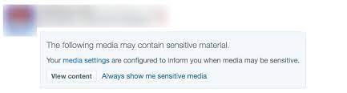
Rob Baldoni, Miranda Morris, Hearsch Jariwala
AIPI 540
Detecting Violent Content in Social Media Images
Notes:
MIRANDA Goal: improve transparency and interpretability

Slide 2
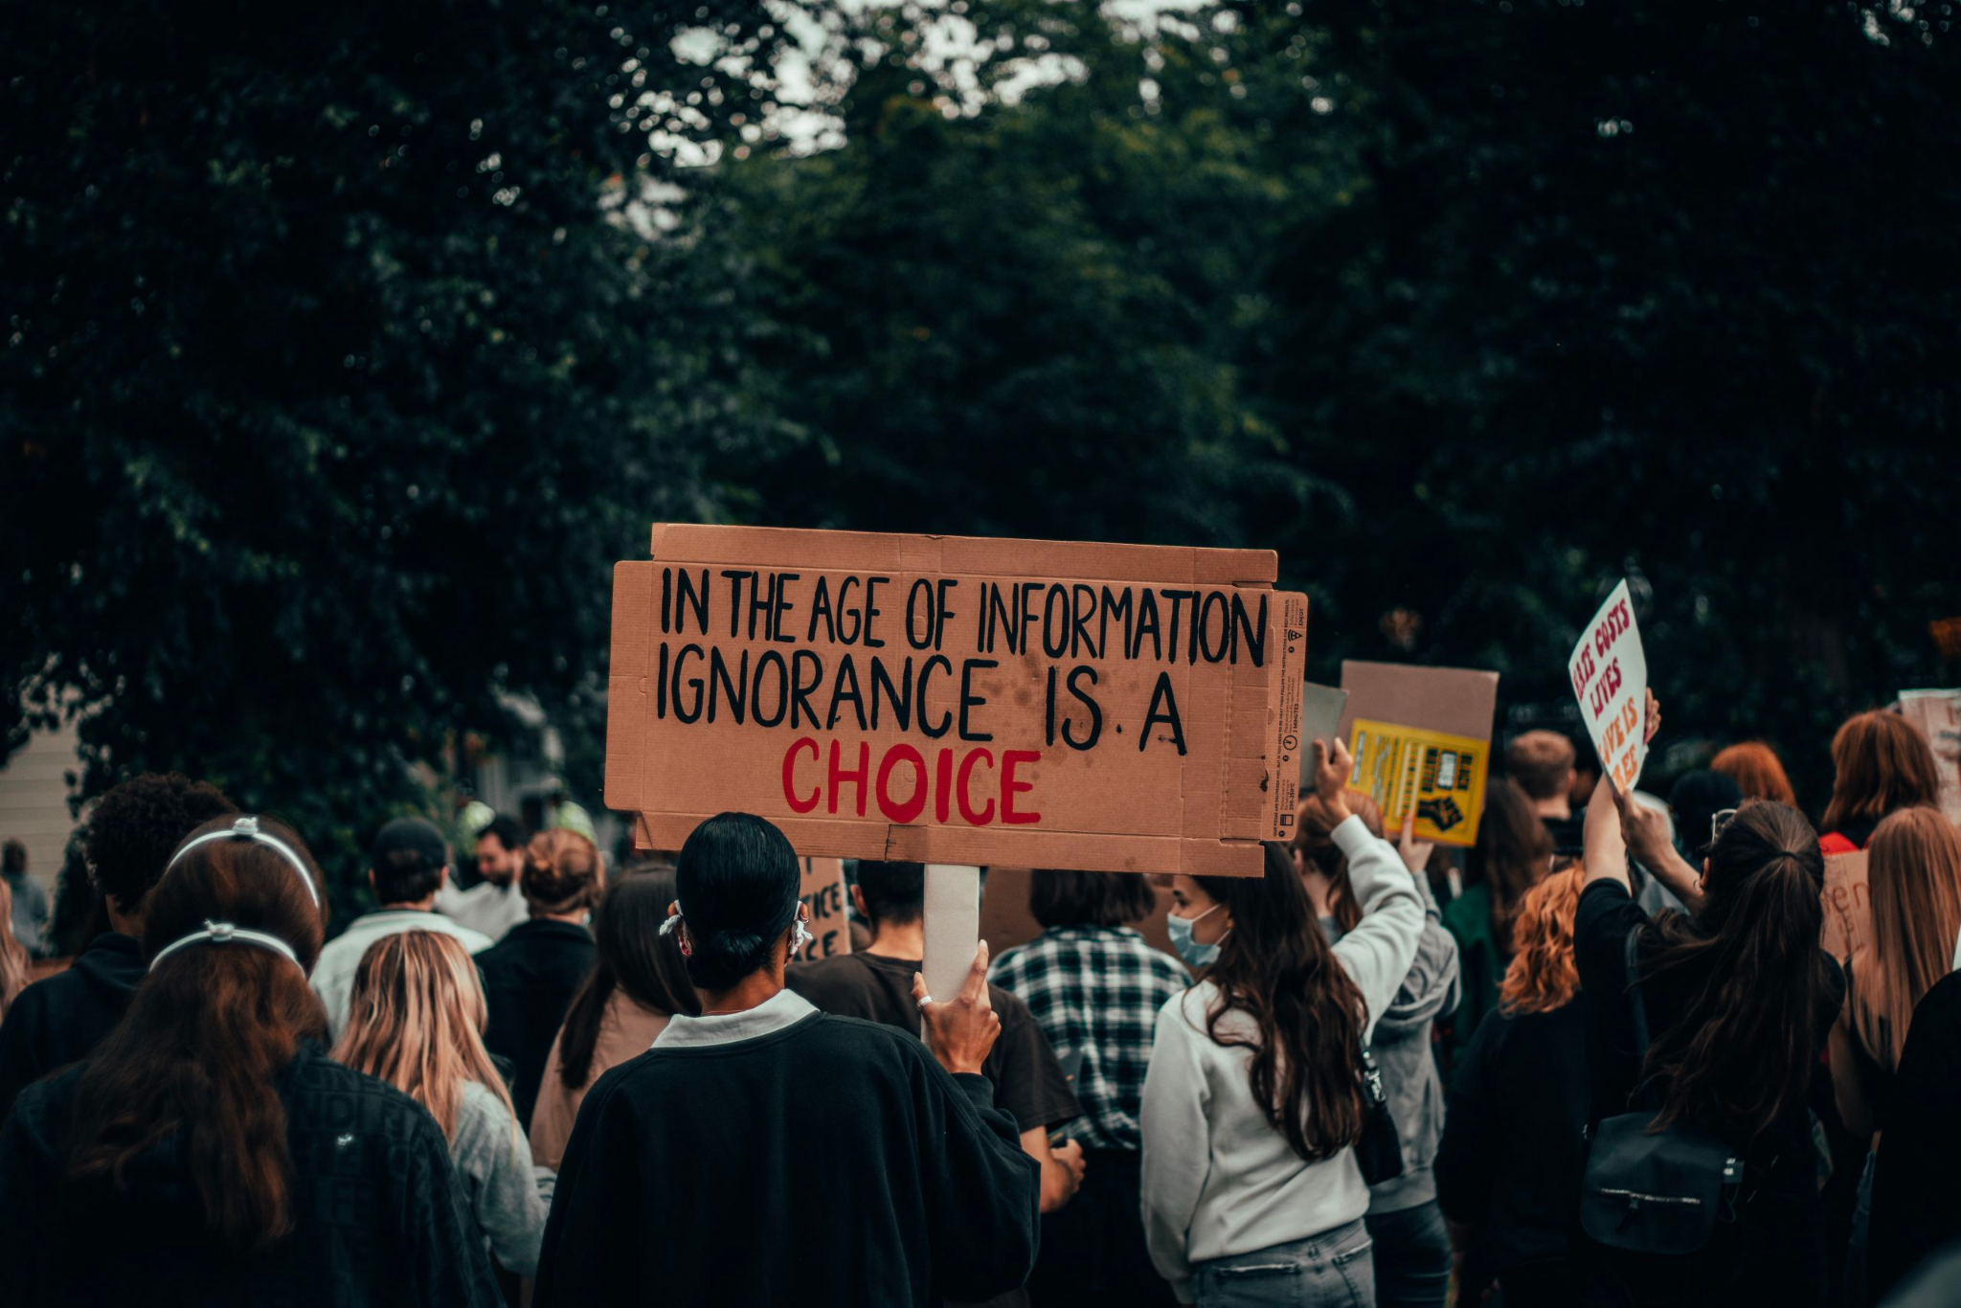
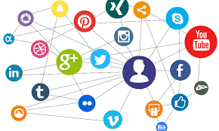
Social Media & News
Social media has become a primary mode of consumption for news and current events
In the age of information (overload), how can we evaluate content – specifically sensitive / violent images?
Notes:
MIRANDA: A large variety of content gets labeled as “sensitive” without a lot of description. We want to increase explainability in these types of calculators
What gets perceived as violent? Can we improve the explainability?

Slide 3
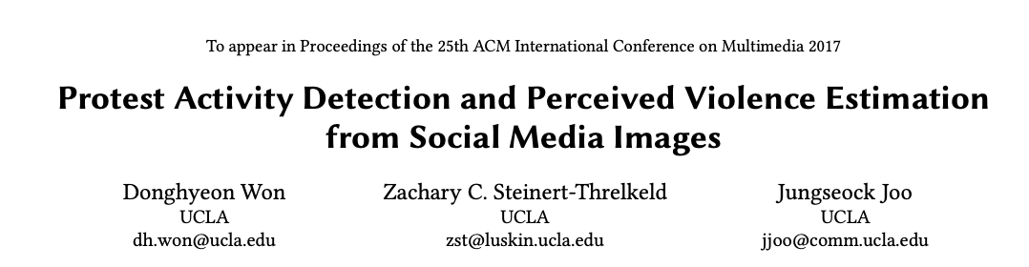
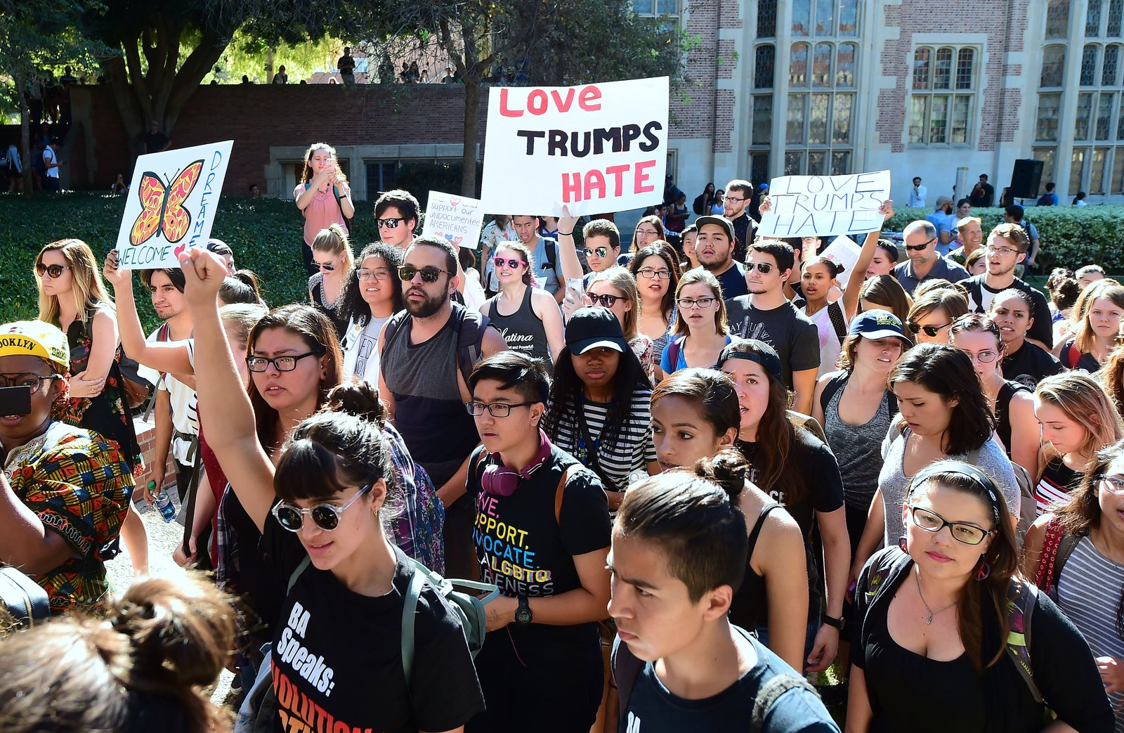
Literature
UCLA Protest Image Dataset → 40,764 images with annotations of visual attributes and sentiments
Peaceful vs violent protests?
Notes:
MIRANDA

Slide 4
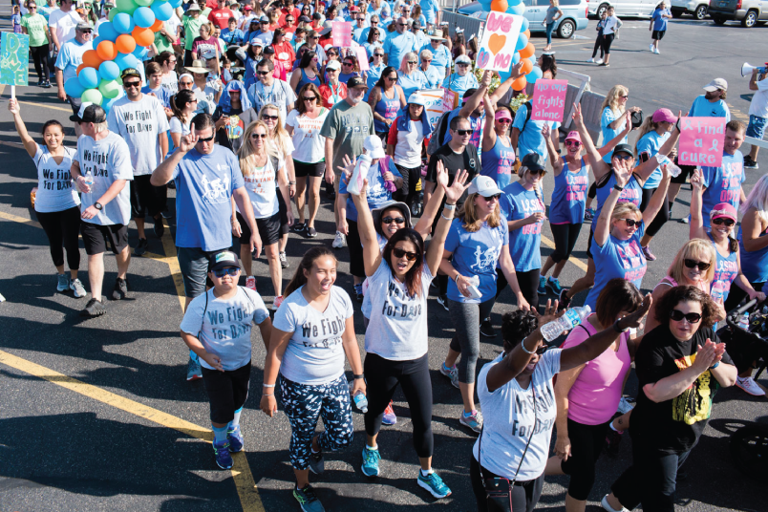
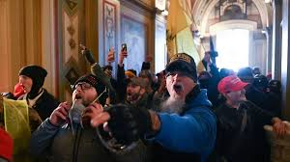
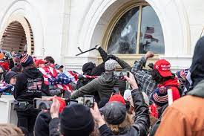
Can existing violence estimation tools differentiate a happy crowd versus an angry mob?
Notes:
MIRANDA: Interesting concept and paper - intrigued by how algorithm was arriving at “perceived violence” calculations? Wanted to add a layer of explainability to this to see if the algorithm was accomplishing its intended goal → verify this by using an explainability approach - CAM
Taking it a step further - what characteristics make up a “violent image”?

Slide 5
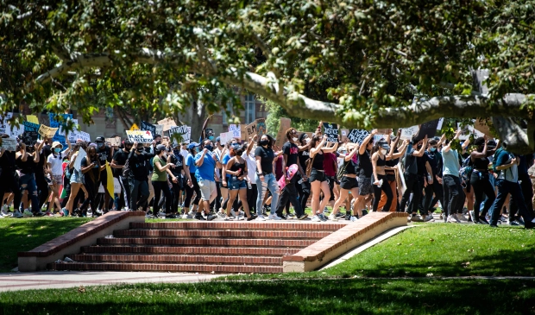
Data Sources
UCLA Protest Image Dataset
→ Collected from 2013-2017
→ 40,764 total images with annotations of visual attributes and sentiments
→ 11,659 images are protest images
→ 29,105 images are hard-negative images (e.g., crowd in stadium)
Notes:
HEARSCH

Slide 6
Data Preprocessing
Image Collection
Multiple sources by web search (Google Image search) and own Twitter data stream
Also used names of recent major protest events (e.g., “Black Lives Matter” or “Women’s March”) based on wikipedia page’s list of protests
Image Annotation
Amazon Mechanical Turk (AMT) was used to annotate each image in the dataset (binary- protest to no protest, binary-visual attributes, level of perceived violence and other sentiments)
The protest activity determination and visual attributes required binary annotations which was assigned to 2 workers, who confirmed the values. If they disagreed a third person would judge.
Perceived violence is subjective and continuous variable so a pairwise comparison-based annotation was used
Notes:
Specifically, images were randomly sampled 58,295 image pairs among 11,659 protest images such that each image is paired up 10 times and assigned 10 workers to evaluate each pair. For each pair, the annotators were asked to choose an image which looks more violent than the other. They used the Bradley-Terry model and estimated the global scores for images such that each image is assigned a real-number score of perceived violence.

Slide 7
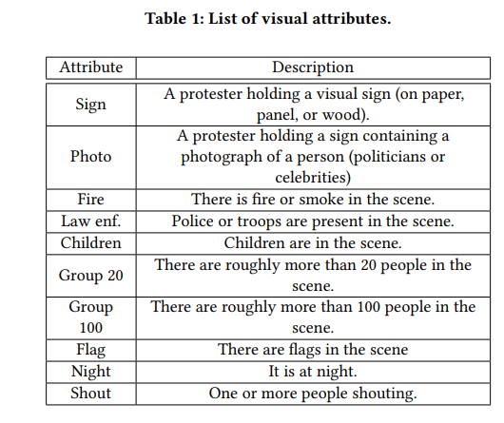
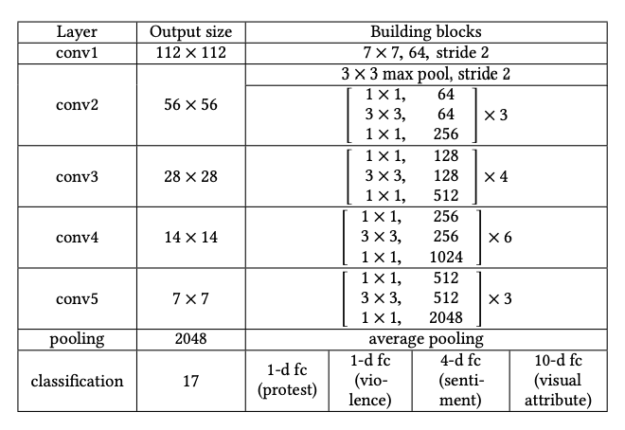
Model Architecture
Model:
CNN with full images as input which then outputs a series of prediction scores in binary image category:
Protest or non-protest (0 to 1)
Visual attributes (0 to 1)
Perceived violence and image sentiment (1+4 - such as happy, violent, fear, sad, etc.)
Model architecture based on a 50-layer ResNet (50 CNNs) with batch normalization and ReLU + final fully connected layer
Metrics:
Binary cross entropy loss to train binary variables (protest and visual attributes)
MSE for violence & sentiment dimensions
Notes:
HEARSCH Binary cross entropy loss - range between 0 & 1
Prediction of likelihood of protest
Fully connected layer

Slide 8
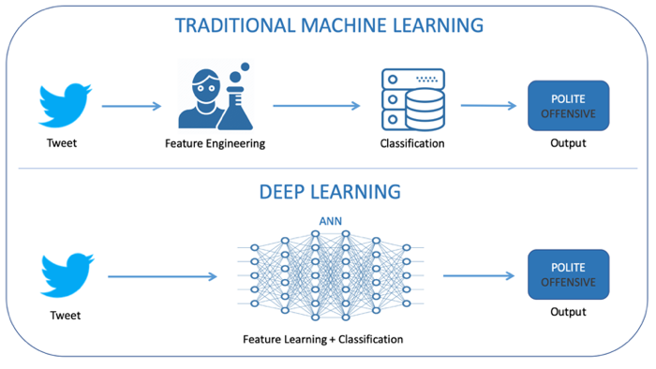
Traditional ML vs. Deep Learning
While traditional ML can be used to classify or cluster event types, that is not the goal of our model.
Our goal is to investigate nuanced characteristics of images to detect perceived violence, rather than to identify the type of event being pictured.
Notes:
HEARSCH

Slide 9


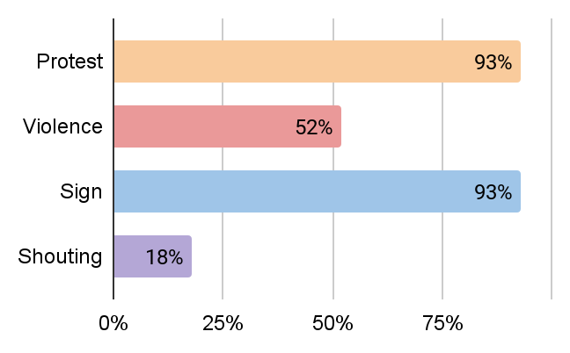
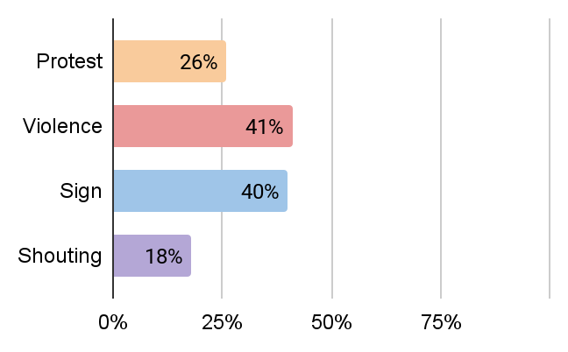
Results
Notes:
ROB

Slide 10
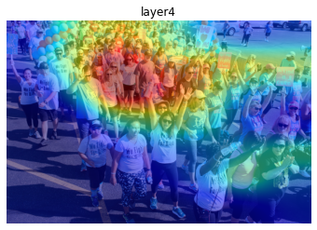
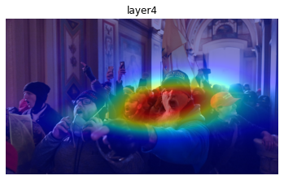
CAM Interpretability
Notes:
ROB

Slide 11
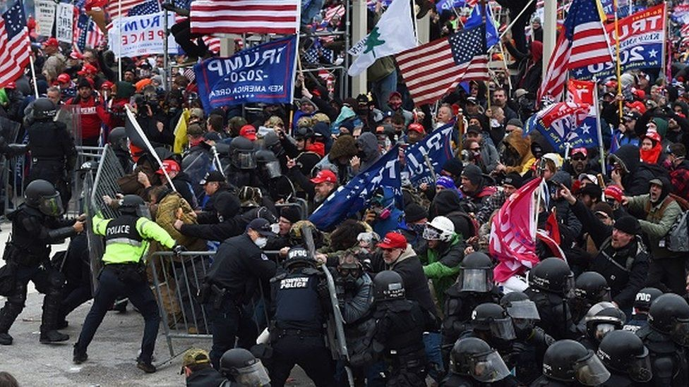
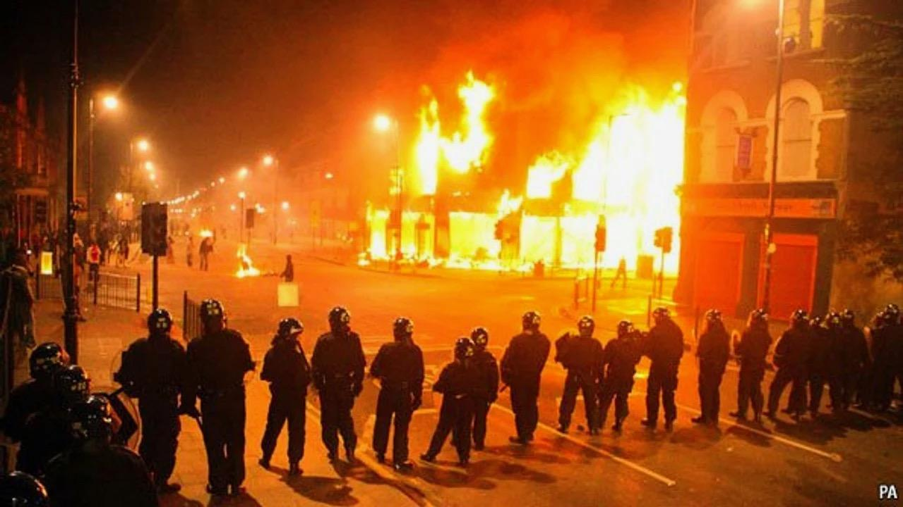
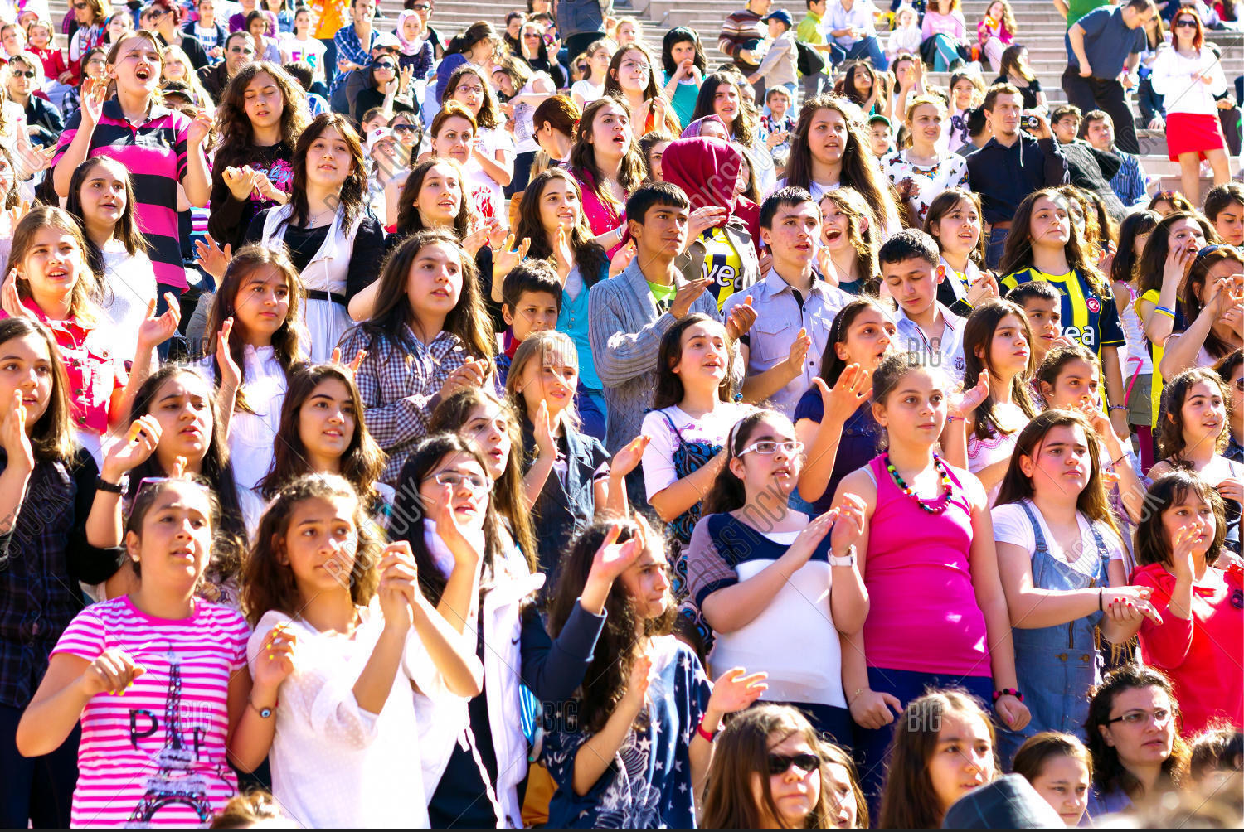
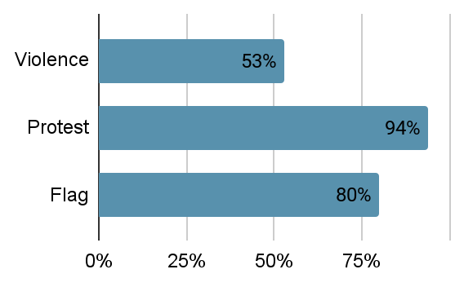
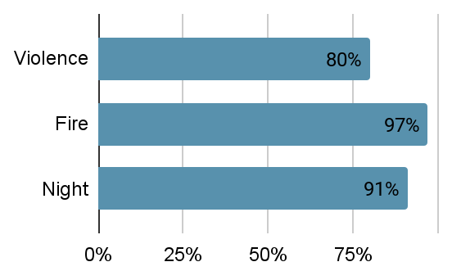
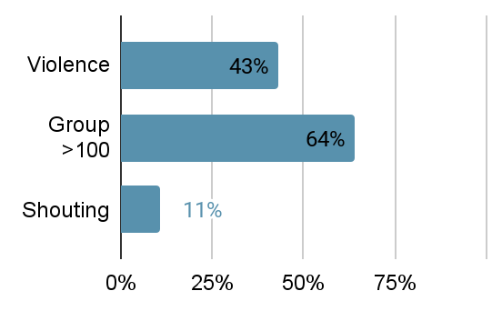
Results

Slide 12
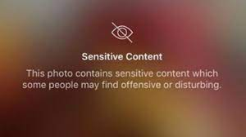


Future Applications: More Descriptive Content Warnings
Notes:
MIRANDA: Interpretability → categorizing “sensitive content” with more descriptive info
Reasons for flagging - transparency for content creators

Slide 13
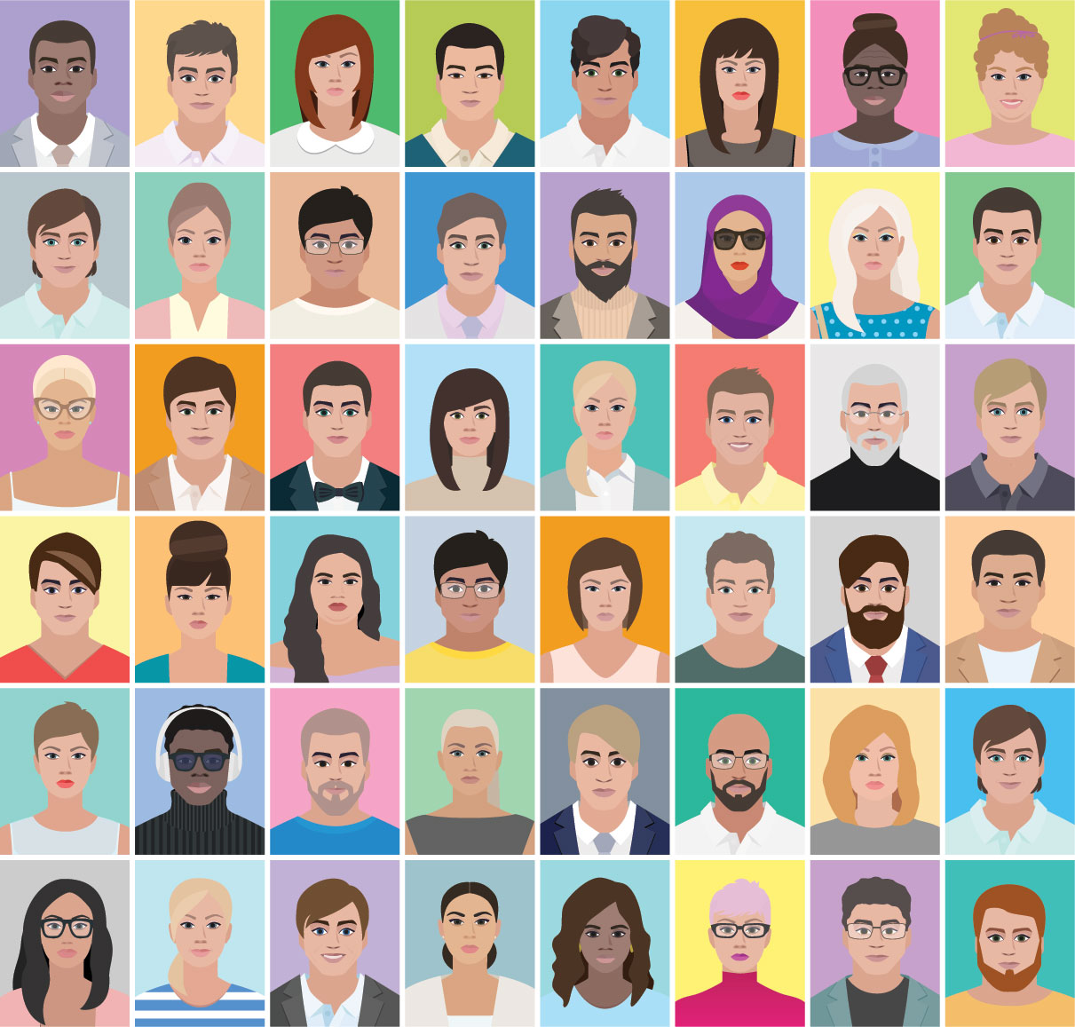
Ethical Considerations
UCLA dataset
Assumptions built into attributes selected for violence calculation (linear calculation & weights assigned to identified attributes)
→ Need to contextualize these attributes - not in a vacuum
Should use more diverse datasets for training, i.e., Gender Shades
Notes:
MIRANDA: We specifically used examples where we knew the actual contexts, like a walk for the cure parade and the armed attack on the capitol, so we could evaluate what the algorithm is picking up on. Given that the “protest” and “violence” scores were higher for the breast cancer walk than for the capitol attack, we can see that there are clear biases introduced in the factors chosen to constitute “violence.” it’s also not unlikely that the racial makeup of the capitol rioters impacts the scores favorably, reducing the perceived violence scores

Slide 14
References
Protest Activity Detection and Perceived Violence Estimation from Social Media Images https://arxiv.org/abs/1709.06204
https://github.com/wondonghyeon/protest-detection-violence-estimation
http://gendershades.org/index.html
https://www.mturk.com
Algorithmic bias detection and mitigation: Best practices and policies to reduce consumer harms
https://www.brookings.edu/research/algorithmic-bias-detection-and-mitigation-best-practices-and-policies-to-reduce-consumer-harms/

